Slide 2
CPU Scheduling
CPU Scheduling Criteria

Slide 3
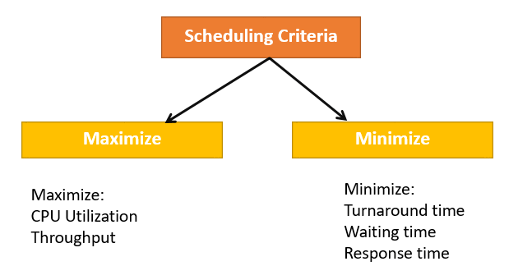
CPU Scheduling
II. CPU Scheduling Criteria
- A CPU scheduling algorithm tries to maximize and minimize the following:

Slide 4
CPU Scheduling
II. CPU Scheduling Criteria
- What types of maximization?
- CPU utilization: CPU utilization is the main task in which the operating system needs to make sure that CPU remains as busy as possible. It can range from 0 to 100 percent. However, for the RTOS, it can be range from 40 percent for low-level and 90 percent for the high-level system.
- Throughput: The number of processes that finish their execution per unit time is known Throughput. So, when the CPU is busy executing the process, at that time, work is being done, and the work completed per unit time is called Throughput.

Slide 5
CPU Scheduling
II. CPU Scheduling Criteria
- What types of Minimize ?
Waiting time: is the specific amount of time that needs to be available in the queue, to be ready to be controlled and used on the CPU.
Response time: is the time from the time the request is sent, until the response is met. Attention: this is the time until the start of the process, not the time. complete progress
Turnaround time: is the time it takes for it to execute a particular process, that is, the time from submitting the process to the time it completes the process.
=> In general CPU utilization and Throughput are maximized and other factors are reduced for proper optimization.

Slide 6
CPU Scheduling
II. CPU Scheduling Criteria
- What is Interval Timer?
Timer interruption is a method that is closely related to preemption
When a certain process gets the CPU allocation, a timer may be set to a specified interval. Both timer interruption and preemption force a process to return the CPU before its CPU burst is complete.
=> Most of the multi-programmed operating system uses some form of a timer to prevent a process from tying up the system forever.

Slide 7
CPU Scheduling
II. CPU Scheduling Criteria
What is Dispatcher?
It is a module that provides control of the CPU to the process.
The Dispatcher should be fast so that it can run on every context switch. Dispatch latency is the amount of time needed by the CPU scheduler to stop one process and start another.
Functions performed by Dispatcher:
+ Context Switching
+Switching to user mode
+Moving to the correct location in the newly loaded program.

Slide 8
CPU Scheduling
Scheduling algorithm

Slide 9
CPU Scheduling
III. Scheduling Algorithm
- The Purpose of a Scheduling algorithm ?
The CPU uses scheduling to improve its efficiency.
It helps you to allocate resources among competing processes.
The maximum utilization of CPU can be obtained with multi-programming.
The processes which are to be executed are in ready queue.

Slide 10
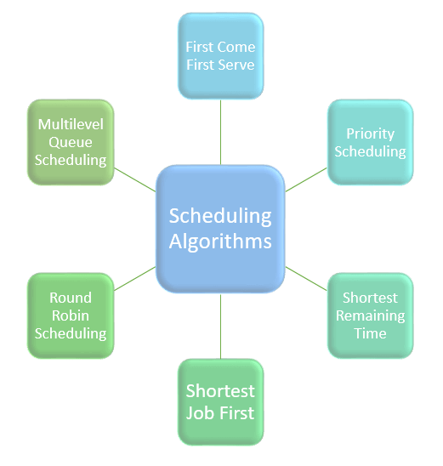
CPU Scheduling
III. Scheduling Algorithm
- What types of Scheduling Algorithm?
First Come First Serve (FCFS)
Shortest-Job-First (SJF) Scheduling
Shortest Remaining Time
Priority Scheduling
Round Robin Scheduling
Multilevel Queue Scheduling

Slide 11
CPU Scheduling
III. Scheduling Algorithm
1. First Come First Serve (FCFS)
Concept:
Scheduling algorithm "First come first serve". Like the name, this algorithm requires: the process that comes first will execute first, the process that comes later will execute later.
First come first serve, it is the same as the data structure: Queue.
A practical example of the First come first serve algorithm is buying tickets at a ticket counter.

Slide 12
CPU Scheduling
III. Scheduling Algorithm
1. First Come First Serve (FCFS)
Problem:
The Non Pre-emptive algorithm or the priority algorithm will not be used, the priority of the process is no longer important.
That's why the system will easily crash, just because of improper process planning
Non-optimal average time
Parallel resource usage is not possible. This will result in the “Convoy” effect. As a result, resource usage (CPU, I/O, etc.) is poor.

Slide 13
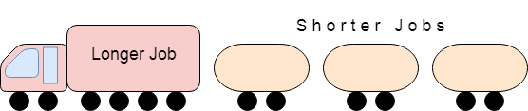
CPU Scheduling
III. Scheduling Algorithm
1. First Come First Serve (FCFS)
What is the Convoy Effect???:
The Convoy effect occurs when there are many processes going on, and it needs to use a resource for a short time but is blocked by a process holding that resource for a long time!
This leads to high resource usage and poor performance

Slide 14
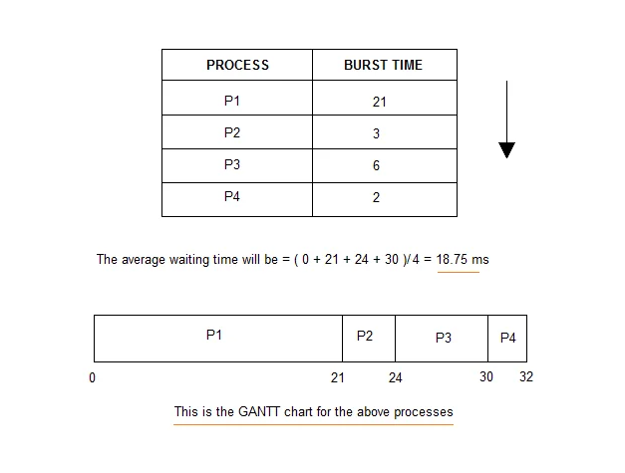
CPU Scheduling
III. Scheduling Algorithm
1. First Come First Serve (FCFS)
Illustration diagram:

Slide 15
CPU Scheduling
III. Scheduling Algorithm
2. Shortest-Job-First (SJF) Scheduling
Characteristics:
It works on the principle that the shortest time or interval will run first.
Will minimize waiting time.
Use in series welding system
For successful execution, the processor must know the execution time of the processes in advance. Therefore, this is actually quite unrealistic.
This scheduling algorithm is optimal if all processes are ready to execute at the same time.

Slide 16
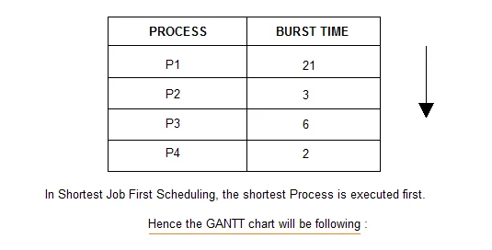
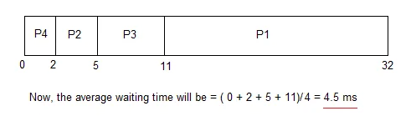
CPU Scheduling
III. Scheduling Algorithm
2. Shortest-Job-First (SJF) Scheduling
Illustration diagram :

Slide 17
CPU Scheduling
III. Scheduling Algorithm
2. Shortest-Job-First (SJF) Scheduling
The Problem of Shortest-Job-First with Non Pre-emptive :
When the readiness times of the processes are different, or the processes are not available in the queue at time 0. In such situations, sometimes the new processes have a short time Wait for the execution to finish. Because in SJF there is no priority when a new process occurs,
Therefore, it leads to a lack of resources, and a shorter process has to wait for a longer process to execute

Slide 18
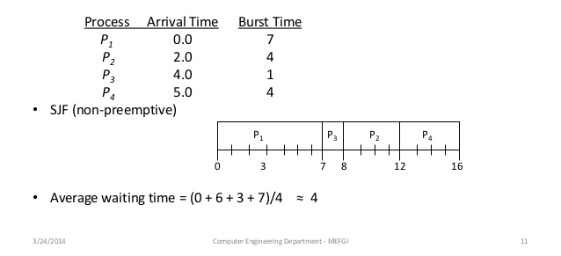
CPU Scheduling
III. Scheduling Algorithm
2. Shortest-Job-First (SJF) Scheduling
The Problem of Shortest-Job-First with Non Pre-emptive :

Slide 19
CPU Scheduling
III. Scheduling Algorithm
3. Shortest Remaining Time
Concept:
In this method the processes will be sorted so that the processes that are about to complete will be deployed first and the processes that are not running will be deployed later. This will prevent new processes from executing and it will execute older processes
Characteristics
This method is mostly applied in a royal environment where short-term work is prioritized
This is not an ideal method to implement it in a shared system, where the CPU time required is unknown.
- However, this is an algorithm that helps to schedule with the shortest time possible.

Slide 20
CPU Scheduling
III. Scheduling Algorithm
4. Priority Scheduling
Concept:
This is a priority-based scheduling method. The scheduler then chooses the tasks and processes to work on by priority
So jobs with higher priority will be executed sooner. And jobs of equal priority will be executed under Round-Robin or First Come First Serve.

Slide 21
CPU Scheduling
III. Scheduling Algorithm
5. Round-Robin Scheduling.
Concept:
Round Robin scheduling algorithm is mainly designed for time sharing systems.
This algorithm is similar to FCFS but in Round Robin scheduling algorithm the priority will be added
This algorithm will overcome the Convoy situation in real FCFS math. Because shutting down all processes gives them a fair share of CPU.

Slide 22
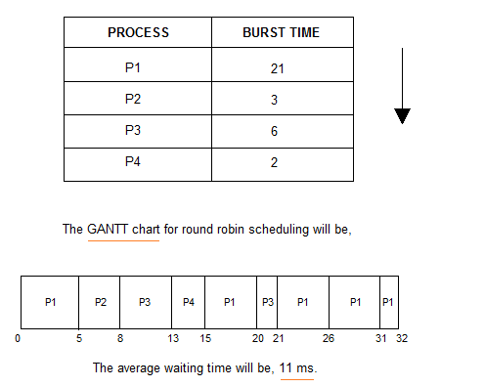
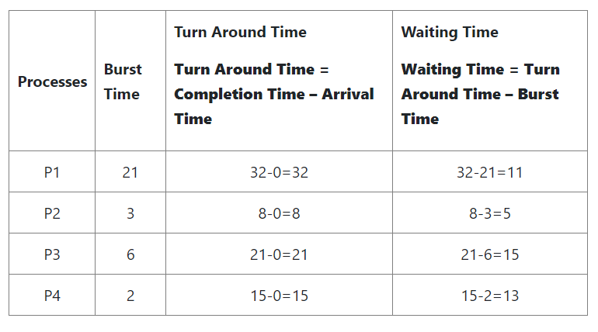
CPU Scheduling
III. Scheduling Algorithm
5. Round-Robin Scheduling.
Illustration diagram :

Slide 23
CPU Scheduling
III. Scheduling Algorithm
5. Round-Robin Scheduling.
Some advantages and Defect :
Advantages:
About the average response time this algorithm gives the best performance
Work will be properly allocated by CPU- Handle all processes without any prioritization.
Each process will have a chance to reschedule after a specific time.
Defect:
Algorithms spend a lot of time switching between processes and planning
Provides great response time and response

Slide 24
CPU Scheduling
III. Scheduling Algorithm
6. Multilevel Queue Scheduling
Concept:
This algorithm, it will split the ready queue into many different separate queues. Processes assign to a queue based on a process-specific property, such as: priority, memory size, etc.
However, this is not an independent scheduling algorithm, it needs to use other algorithms to schedule jobs.

Slide 25
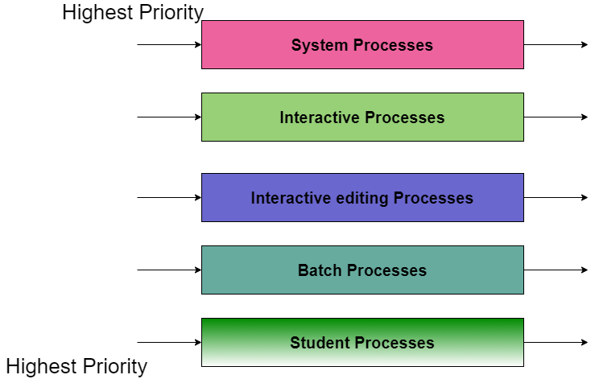
CPU Scheduling
III. Scheduling Algorithm
6. Multilevel Queue Scheduling
Illustration diagram:
For System Processes: First Come First Serve(FCFS) Scheduling.
For Interactive Processes: Shortest Job First (SJF) Scheduling.
For Interactive editing Processes: Shortest Job First (SJF) Scheduling.
For Batch Processes: Round Robin(RR) Scheduling
For Student Processes: Priority Scheduling

Slide 26
CPU Scheduling
III. Scheduling Algorithm
6. Multilevel Queue Scheduling
Some advantages and Defect :
Advantages:
We can apply many different types of scheduling algorithms
Defect:
It will cause low-level processes to not execute or, if present, to wait for a long time(Convoy).

Slide 27
CPU Scheduling
Thanks for listening
SV: Phạm Tiến Thành Công
MSSV: 20010886

